Slide 1
SignEase
Emotion Detection & Sign Language Translator with Tutorial Hub
Final Year Project Presentation

Slide 2
Members
Muhammad Ahmad (F2021266346)
Akasha Saleem (F2021266333)
Kainat Mehmood (F2021266072)
Rafay Zeeshan (F2021266304)

Slide 3
Project Introduction
SignEase is a full-stack AI-powered system to support the deaf and hard-of-hearing community via:
- Emotion Detection
- Real-time Sign Language Translation
- Interactive Tutorial Hub

Slide 4
Motivation
There is a lack of real-time and affordable sign language translators.
No centralized learning platform exists for ASL.
We aim to bridge the communication gap for deaf and mute individuals.

Slide 5
Problem Statement
Sign language users face difficulty expressing emotions and communicating clearly due to a lack of real-time, expressive tools.
Existing tools are limited, expensive, or slow.

Slide 6
Project Objective
- Detect macro-emotions from facial expressions
- Translate sign language to text/speech
- Teach ASL via a step-by-step tutorial hub

Slide 7
System Overview
The project is divided into 4 major modules:
1. Emotion Detection
2. Sign Language Translator
3. ASL Tutorial Hub
4. Chatbot

Slide 8
Frontend Technology
- React.js
- Tailwind CSS
- Responsive UI
- User dashboard with progress tracking and feedback system

Slide 9
Backend Technology
- Django with RESTful APIs
- MySQL Workbench for database
- API integrations (Gemini, ElevenLabs)
- AI Models for sign and emotion

Slide 10
AI Models Used
- Emotion: ConvNext Tiny, EfficientNetB0, MobileNetV2
Accuracy 83%
- Sign Language: MobileNetV2 (ASL Alphabets & Numbers)
- Accuracy > 98% on both models

Slide 11
Emotion Detection Module
Captures facial expressions in real-time
Classifies mood (Happy, Angry, Surprised etc.)
Improves context understanding in communication

Slide 12
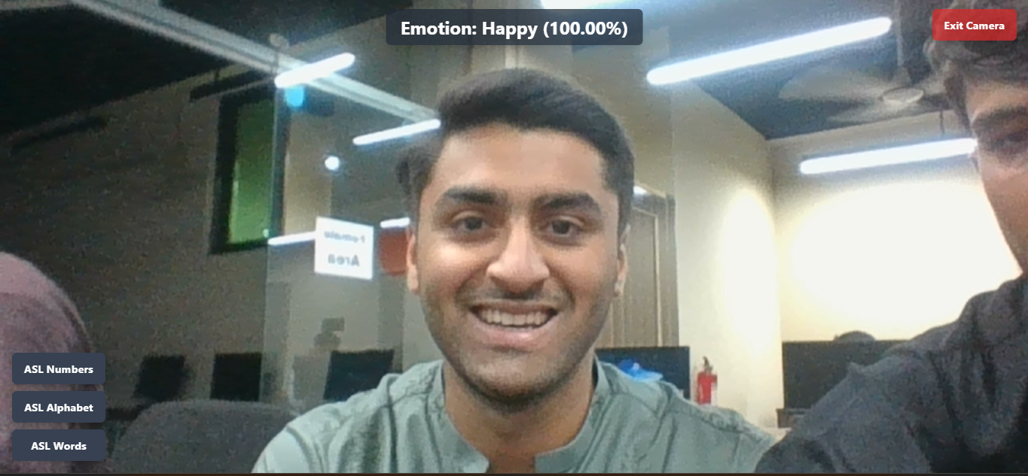
Emotion testing

Slide 13
Sign Language Translator
- Recognizes:
• Alphabets
• Numbers
• Words (future)
- Converts signs to text
- Text-to-speech enabled

Slide 14
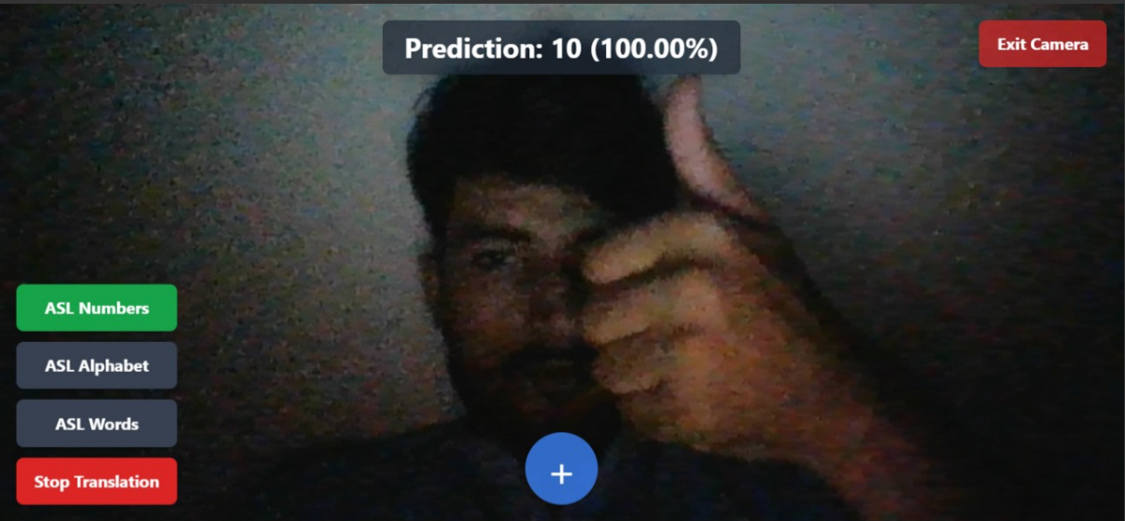
Test number on low quality image

Slide 15
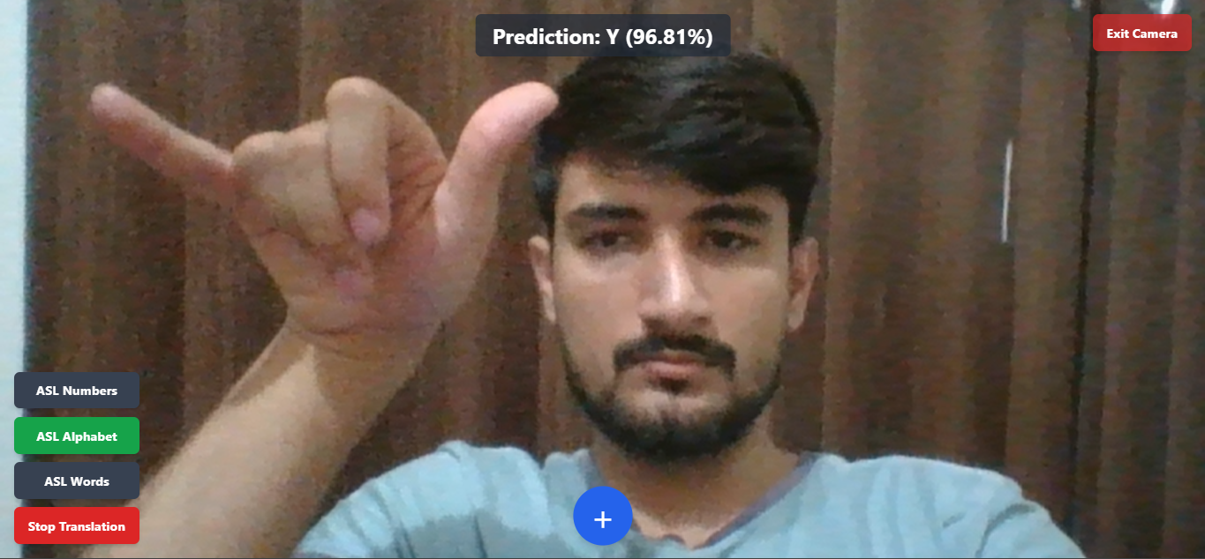
Test Alphabet

Slide 16
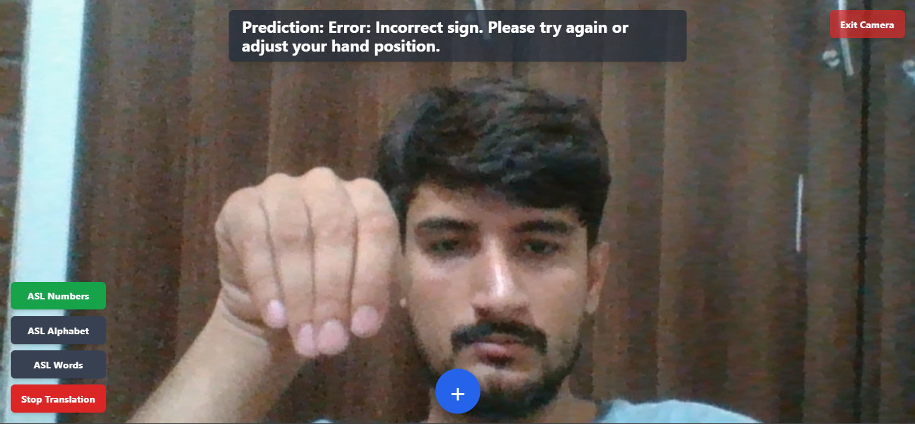
Filter wrong sign

Slide 17
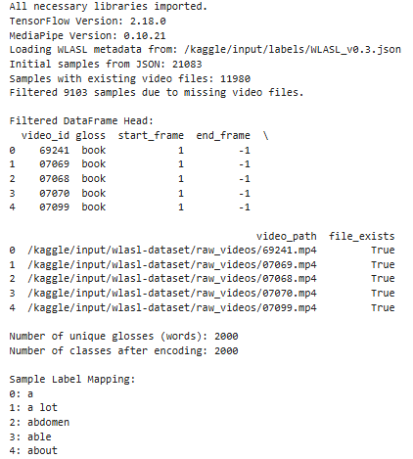
WLASL (2000 Classes)

Slide 18
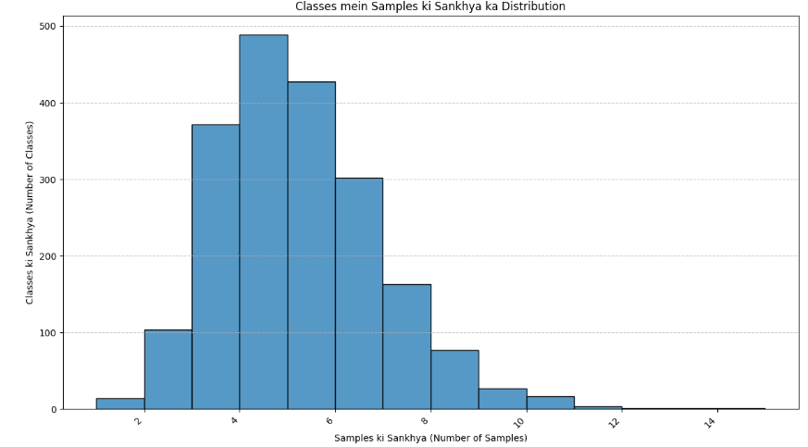
WLASL (Data Distribution)

Slide 19
Tutorial Hub
- Learn ASL step-by-step
- Modules:
• Alphabets
• Numbers
• Vocabulary
- Quiz after each section
- Voice output & progress tracking

Slide 20
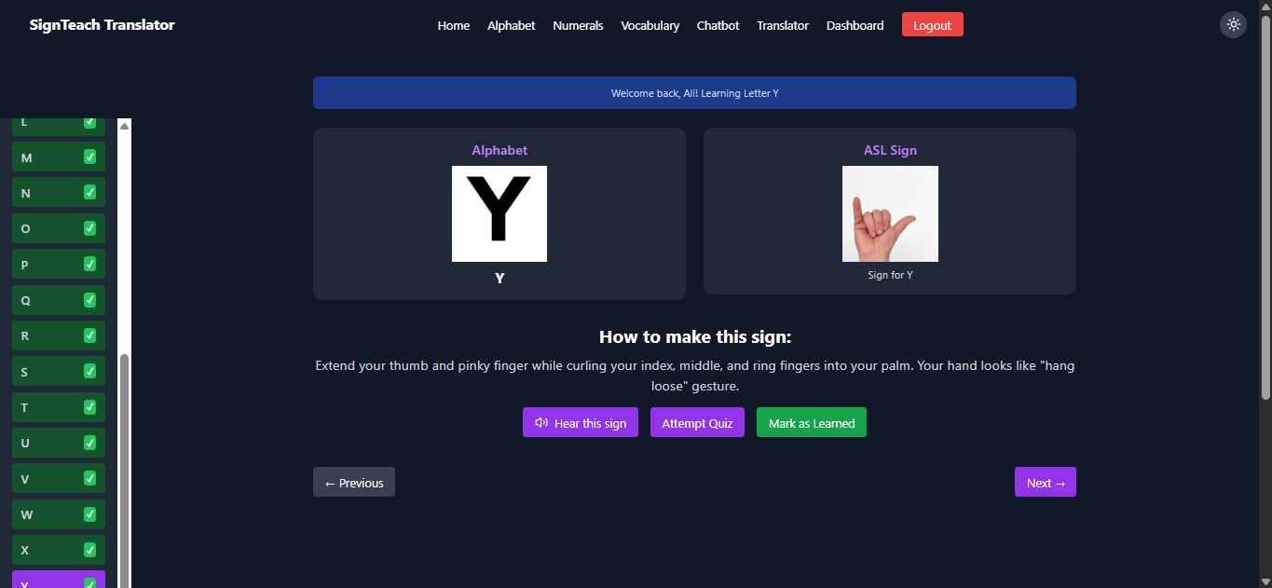
Alphabet Tutorial

Slide 21
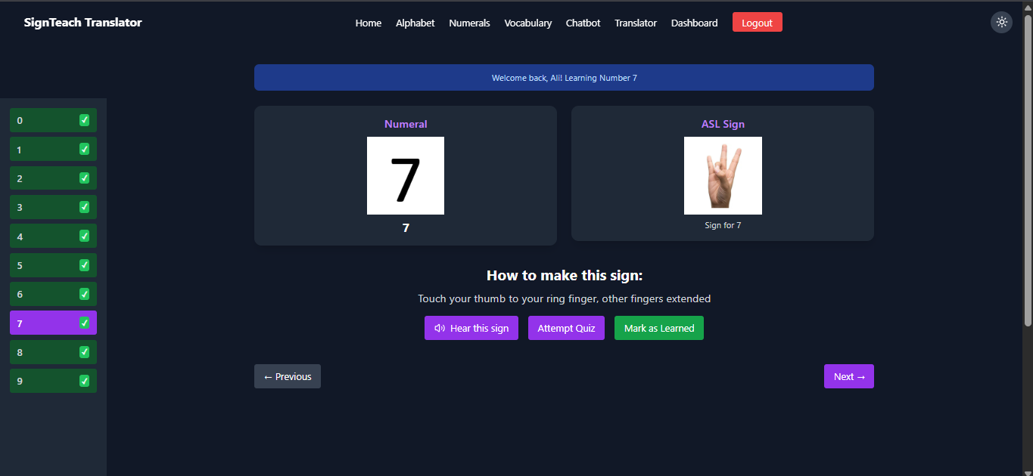
Numerals Tutorial

Slide 22
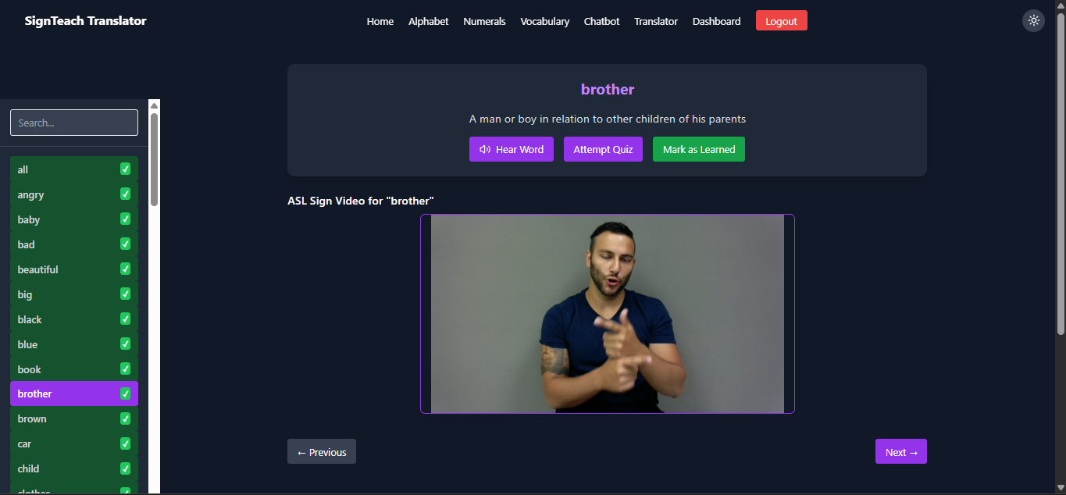
Vocabulary Tutorial

Slide 23
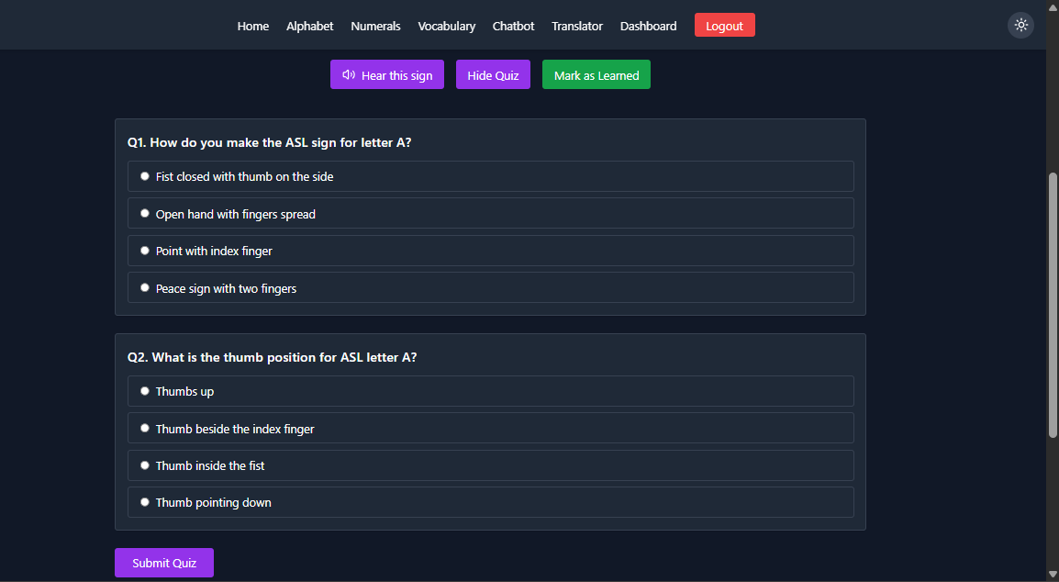
Quiz After Each Section

Slide 24
Dashboard Features
- Personalized learning tracking
- Quiz attempts and scores
- Learning level monitoring
- Review, feedback, and recommendations

Slide 25
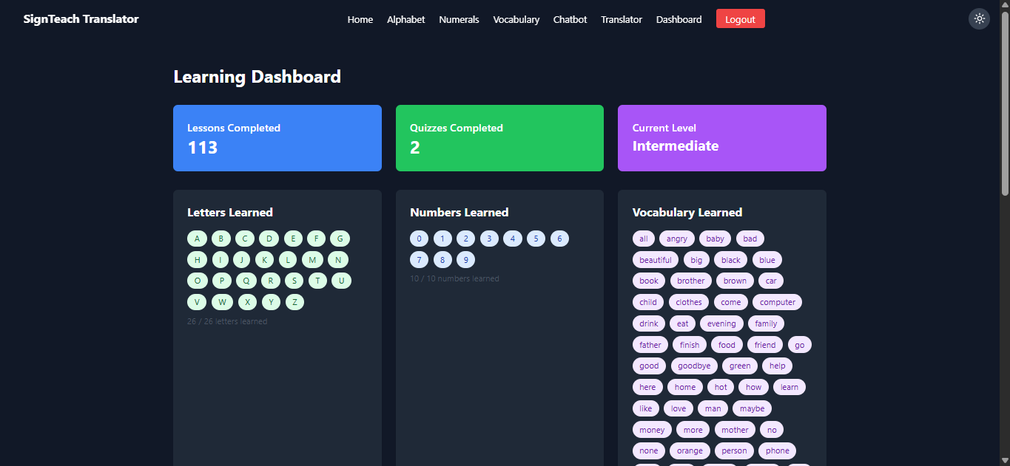
Dashboard

Slide 26
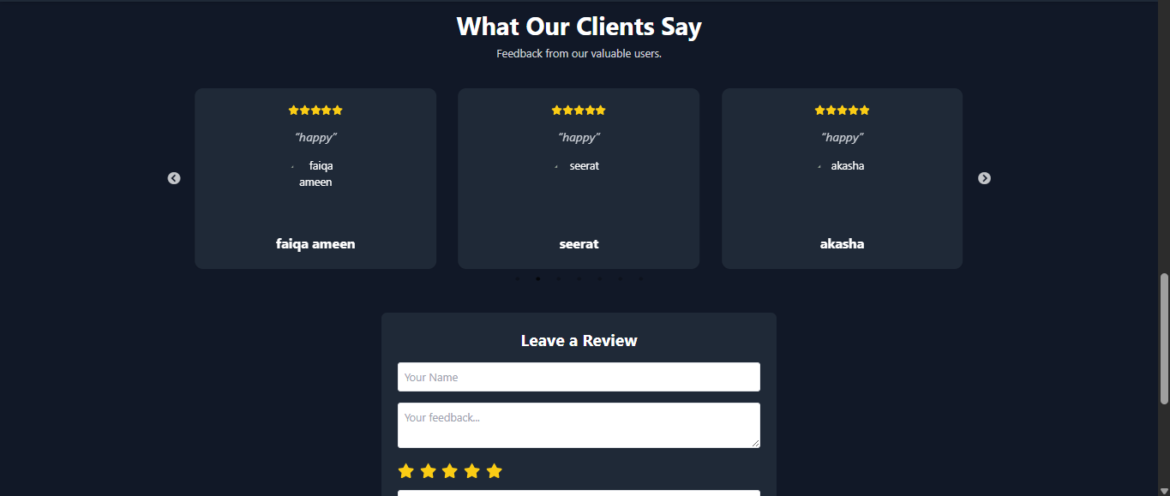
Review

Slide 27
Chatbot Module
- ASL-focused chatbot
- Allows users to ask questions via image or text
- Verifies correct signs
- Quiz guidance and ASL tips

Slide 28
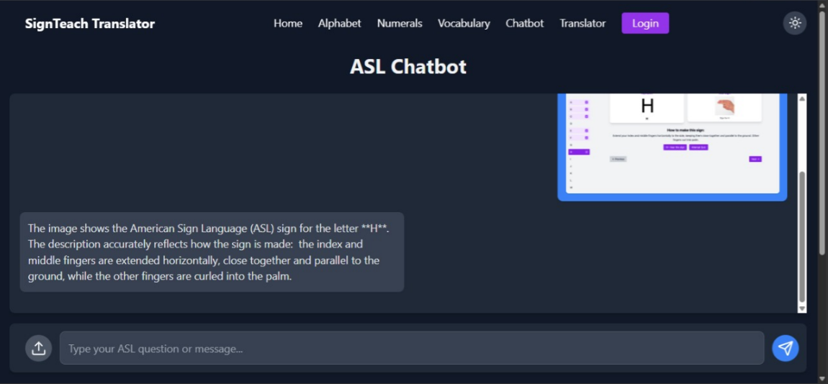
Chatbot

Slide 29
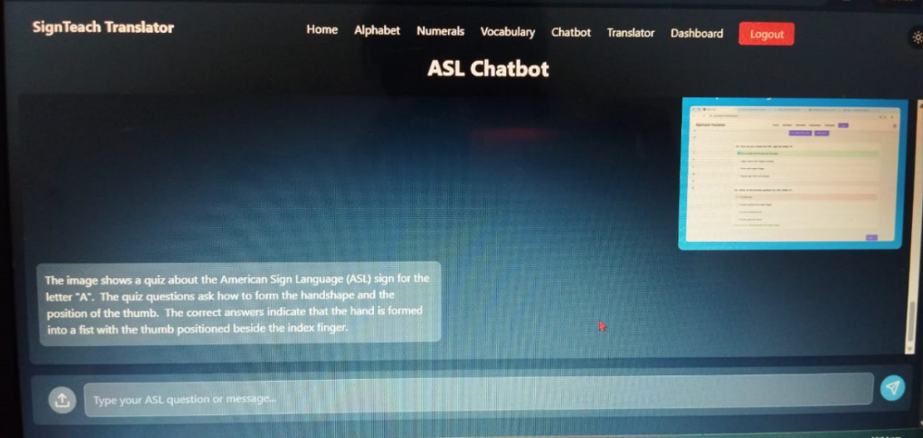
Chatbot about Quiz

Slide 30
Target Users
- Deaf & Mute Individuals
- Educational Institutes
- Special Education Centers
- Developers/Researchers

Slide 31
Datasets Used
- Emotion: AffectNet
- ASL Numbers: 3GB+ dataset, 11k+ images
- ASL Alphabets: 5.6GB+, 13.7k files
- Words: WLASL Dataset (future work)

Slide 32
Training Results
- Numbers Model:
Accuracy: 99.5%, Loss: 0.0326
- Alphabets Model:
Accuracy: 98.95%, Loss: 0.0344

Slide 33
System Architecture
- Full-stack application with modular architecture
- Uses RESTful APIs to connect frontend & backend
- Real-time camera and voice integration

Slide 34
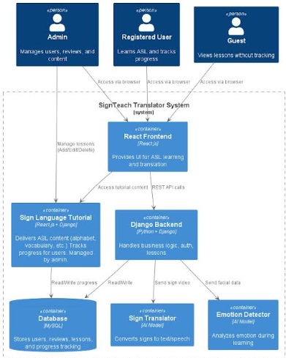
System Architecture

Slide 35
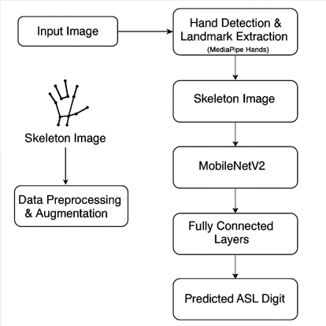
Model Architecture

Slide 36
Use Cases
- Learn sign language
- Real-time translation
- Emotion-aware communication
- Dashboard monitoring
- Feedback system

Slide 37
Real-World Impact
- Enables deaf/mute users to communicate freely in classrooms, hospitals, and industry
- Promotes inclusivity and accessibility

Slide 38
Challenges
- Imbalanced datasets
- Real-time performance tuning
- High model accuracy
- Limited samples for words dataset

Slide 39
Future Work
- Add more sign classes (words/sentences)
- Real-time speech-to-sign conversion
- Gamified learning
- Mobile app
- Wearable integration

Slide 40
Conclusion
SignEase provides an accessible, AI-powered platform to support sign language learning, translation, and emotion recognition — making communication inclusive.

